Slide 1
Style in Xamarin.Form

Slide 2
The basic Style
Styles allow the appearance of visual elements to be customized.
Xamarin.Forms applications often contain multiple controls that have an identical appearance.
Let suppose:
I have created 3 Labels with same appearance
Setting the appearance of each individual control can be repetitive and error prone. Instead, a style can be created that defines the appearance, and then applied to the required controls.

Slide 3
Apply styles in Entry control:-
Same background color
Same font type
Same font size
Same alignment

Slide 4
Creating a Style
<ContentPage.Resources>
<ResourceDictionary>
<Style TargetType="Label">
<Setter Property="HorizontalOptions" Value="Center" />
<Setter Property="VerticalOptions" Value="CenterAndExpand" />
<Setter Property="FontSize" Value="Large" />
</Style>
<ContentPage.Resources>
<ResourceDictionary>

Slide 5
In order to apply a Style, the target object must be a VisualElement that matches the TargetType property value of the Style.
Each Style instance contains a collection of one or more Setter objects, with each Setter having a Property and a Value. The Property is the name of the bindable property of the element the style is applied to, and the Value is the value that is applied to the property.
A Style object is always defined in a ResourceDictionary.

Slide 6


Slide 7
Now apply style
<Label Text=“This Label is applied style"
Style="{StaticResource labelStyle}" />

Slide 8
Implicit Styles
An implicit style is one that's used by all controls of the same TargetType, without requiring each control to reference the style.
Example:
(No need to specify x:Key on Style)
<Style TargetType="Entry">
<Setter Property="HorizontalOptions" Value="Fill" />
<Setter Property="VerticalOptions" Value="CenterAndExpand" />
<Setter Property="BackgroundColor" Value="Yellow" />
<Setter Property="FontAttributes" Value="Italic" />
<Setter Property="TextColor" Value="Blue" />
</Style>

Slide 9
Explicit style
An explicit style is one that is selectively applied to controls by setting their Style properties.
(specify x:Key on Style)
Example:

Slide 10
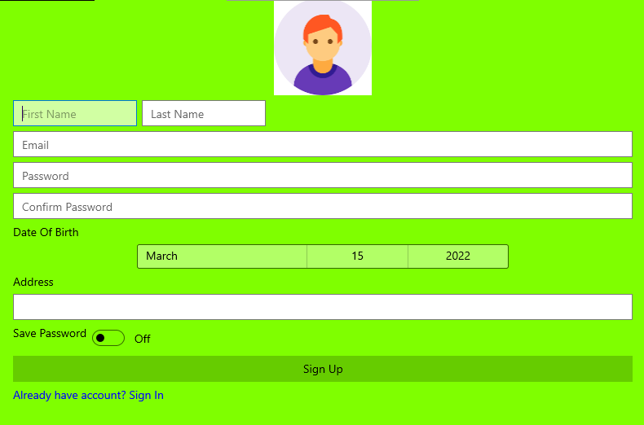

Slide 11


Slide 12
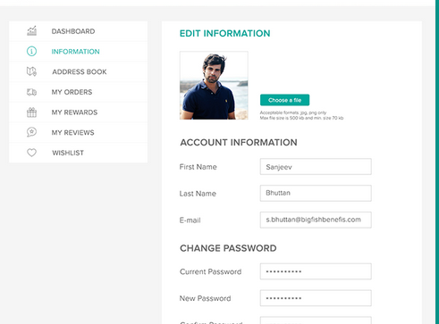

Slide 13
Dynamic Style:
Changing style at run time
By using Style="{DynamicResource buttonStyle}“ and through c#

Slide 14
Dynamic Style→>>
Design Part:
<ContentPage.Resources>
<ResourceDictionary>
<Style x:Key="mystyle1" TargetType="Label">
<Setter Property="TextColor" Value="Red"></Setter>
</ResourceDictionary>
</ContentPage.Resources>
<StackLayout Orientation="Vertical">
<Label Text="Hello Kumar" Style="{DynamicResource mystyle}"></Label>
<Button x:Name="btnColor" Text="Color" Clicked="onColor"></Button></StackLayout>
C# Coding:
public void onColor(object sender, EventArgs ar)
{
Resources["mystyle"] = Resources["mystyle1"];
}

Slide 15
Inheritance style
Styles can derive from other styles. The Style class includes a property named BasedOn of type Style. In code, you can set this BasedOn property directly to another Style object.
<Style x:Key="Style2" TargetType="Button" BasedOn="{StaticResource Style1}">
<Setter Property="FontSize" Value="Large"/>
</Style>

Slide 16
Inheritance style Example:
<Style x:Key="Style1" TargetType="View">
<Setter Property="HorizontalOptions" Value="CenterAndExpand"/>
<Setter Property="VerticalOptions" Value="Center"/>
</Style>
<Style x:Key="Style2" TargetType="Button" BasedOn="{StaticResource Style1}">
<Setter Property="FontSize" Value="Large"/>
</Style>

Slide 17
Full form of UWP is?
A) Universal Windows Platform
B) Universal Windows Programming
C) Unified Windows Programming
D) None

Slide 18

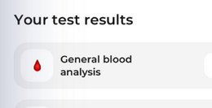
Create Health Care App apply style inheritance on it.

Slide 19
A control that can edit multiple lines of text is called?
A) Entry
B) BoxView
C) Editor
D) TextView

Slide 20
ItemsSource is the property of ?
A) ListView
B) Editor
C) BoxView
D) DropDownList

Slide 21
In DatePicker control event argument name is?
A) DateChangedEventArgs
B) DateEventArgs
C) EventArgs
D) None

